Slide 1
Android Architecture Components
Room, LiveData and ViewModel

Slide 2
Android Architecture Components:
A new collection of libraries that help you design robust, testable, and maintainable apps.
It helps us developers address two pain points:
Manage our UI components lifecycle
Persist data over configuration changes
Maintaining data over orientation changes and handling our objects with lifecycle is hard. That’s why, to avoid the hassle, you lock your apps in Portrait mode.
Room is a library that saves you all such trouble. Now you can query your data without having to deal with cursors or loaders. You can define your database by adding annotations in your Model class.

Slide 3
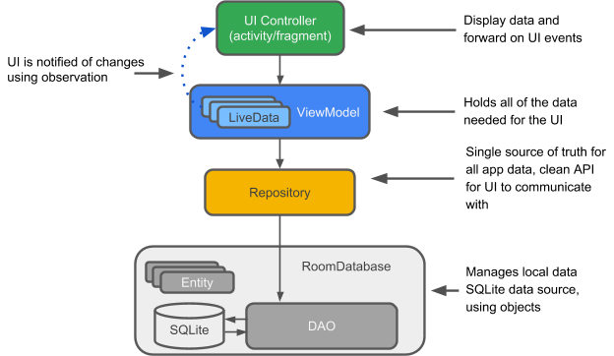
Main Components
Room
ViewModel
LiveData

Slide 4
Room
Remember the amount of boilerplate code you had to write to create and manipulate even a very small database? You had to define the database structure, create an SQLiteOpenHelper class etc.
Room provides an abstraction layer over SQLite to allow fluent database access while harnessing the full power of SQLite.
compile-time verification of SQL queries — each @Query and @Entity is checked at the compile time, so there’s no risk of runtime error that might crash your app (and it doesn’t check only syntax, but also e.g. missing tables)
very little boilerplate code

Slide 5
Room
Entity: this is an annotated class that describes a database table
DAO: Data access object. A mapping of SQL queries to functions. You used to have to define these painstakingly in your SQLiteOpenHelper class. When you use a DAO, you call the methods, and Room takes care of the rest.
Room database: Database layer on top of SQLite database that takes care of mundane tasks that you used to handle with an SQLiteOpenHelper. Database holder that serves as an access point to the underlying SQLite database. The Room database uses the DAO to issue queries to the SQLite database.

Slide 6
Create the entity
@Entity(tableName = “name_of_your_table")
Each @Entity class represents an entity in a table. Annotate your class declaration to indicate that it's an entity. Specify the name of the table if you want it to be different from the name of the class.
@PrimaryKey
Every entity needs a primary key. To keep things simple, each word acts as its own primary key.
@NonNull
Denotes that a parameter, field, or method return value can never be null.
@ColumnInfo(name = “name_of-your_column")
Specify the name of the column in the table if you want it to be different from the name of the member variable.
Every field that's stored in the database needs to be either public or have a "getter" method.

Slide 7
Create the DAO
In the DAO (data access object), you specify SQL queries and associate them with method calls. The compiler checks the SQL and generates queries from convenience annotations for common queries, such as @Insert.
The DAO must be an interface or abstract class.
@Dao
public interface UserDao {
@Insert
void insert(User user);
@Query("DELETE FROM user_table")
void deleteAll();
@Query("SELECT * from user_table ORDER BY uid ASC")
List<User> getAllUsers();
}

Slide 8
The LiveData class
When data changes you usually want to take some action, such as displaying the updated data in the UI. This means you have to observe the data so that when it changes, you can react.
LiveData, a lifecycle library class for data observation, solves this problem. Use a return value of type LiveData in your method description, and Room generates all necessary code to update the LiveData when the database is updated.
@Query("SELECT * from user_table ORDER BY uid ASC") LiveData<List<User>> getAllUsers();

Slide 9
Add a Room database
Room is a database layer on top of an SQLite database. Room takes care of mundane tasks that you used to handle with an SQLiteOpenHelper.
Room uses the DAO to issue queries to its database.
By default, to avoid poor UI performance, Room doesn't allow you to issue database queries on the main thread. LiveData applies this rule by automatically running the query asynchronously on a background thread, when needed.
Room provides compile-time checks of SQLite statements.
Your Room class must be abstract and extend RoomDatabase.
Usually, you only need one instance of the Room database for the whole app.
@Database(entities = {User.class}, version = 1)

